Slide 1
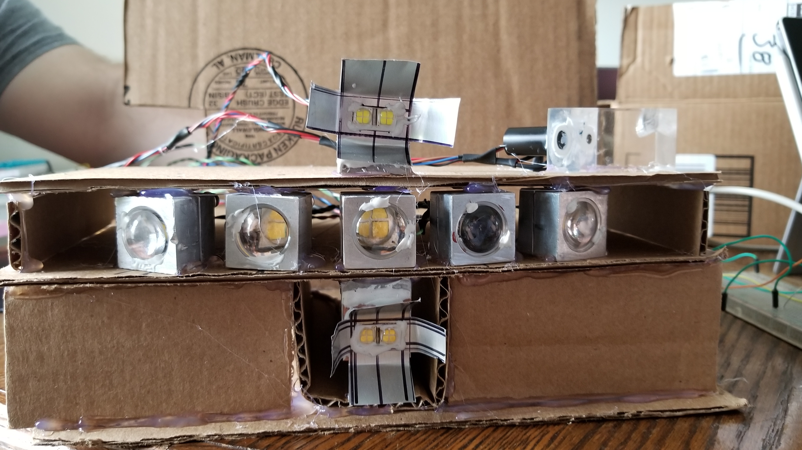
Environment Adaptive Automotive Headlight
Group 5
Justin Kleier – PSE
Michael Zeiher – PSE
Justin Owle – CE
Ivan Bernal Garcia – EE
SPRING 2020

Slide 2
Motivation
Driving at night can be up to three times more dangerous than daytime driving. This is due to decreased reaction time caused visual impairments such as lack of illumination and flash blindness.
Lack of illumination limits the sight distance as well as depth perception and peripheral vision.
Oncoming headlights can cause flash blindness. Which can leave an afterimage seen as a dark spot in our vision causing us to not see clearly and can even disorient drivers.

Slide 3
Goals and Objectives
Goals | Objectives
Increase safety for the driver | Increase light output for better sight clarity Increase sight distance (farther light throw) Proper beam selection (I.e. High, Low and Fog light)
Increase safety for oncoming drivers | Adaptive beam to decrease glare and effects of flash blindness/afterimage
Abide by Florida Laws on lighting requirements during specific weather conditions | Turn on Headlights with rain, fog or smoke Only use Low beams and Fog lights during rain, fog and smoke conditions (Eliminates tunnel effect) Lights on from dusk to dawn hours

Slide 4
Specification
1. | FDOT (Florida Department of Transportation) standards
2. | Rain, fog and ambient light sensor to signal headlights to turn on
3. | Image processing/ software to control the LED brightness and on off state
5. | 12V at 20 Amps supply limit from car battery (Measure both turn on and constant state)
6. | Low beam LEDs Controlled by a microcontroller
7. | Sensor sampling 2 - 5 Hz
8. | Must determine if there is an oncoming car
9. | Determine the position of the car or light source
10. | Consider back scatter from the headlight to help determine weather
11. | Measure effective sensing distance
12. | Measure effective response time

Slide 5
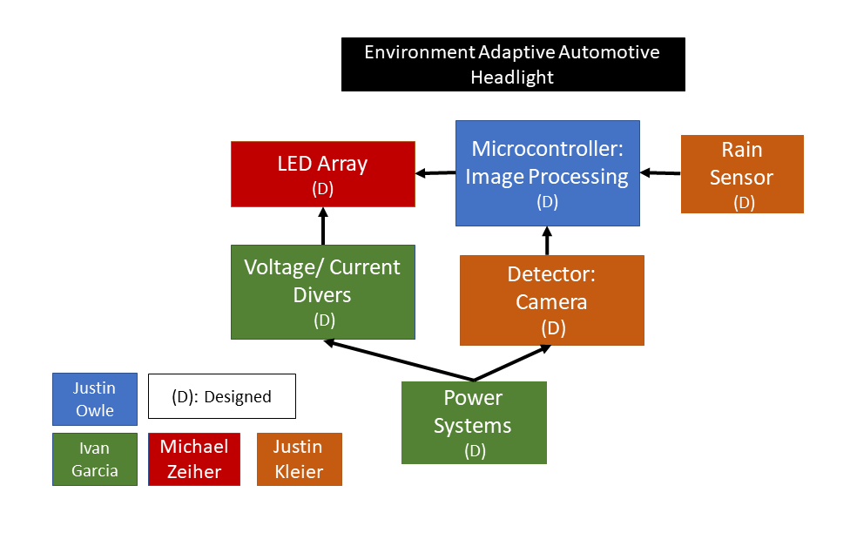
System Block Diagram

Slide 6
Optical Systems
Low Beam
High Beam
Fog Light
Rain sensor
Light Sensor

Slide 7
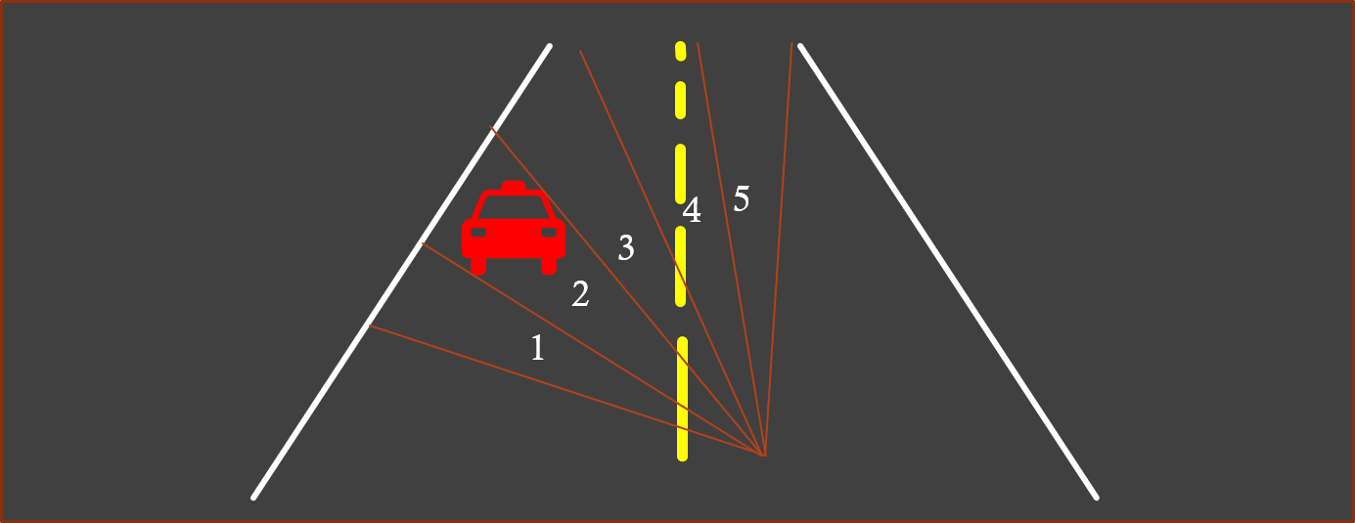
Low Beam
Our low beam is the adaptive part of the system consisting of 5 LEDs each projecting an equal portion of the systems full field of view (FOV)

Slide 8
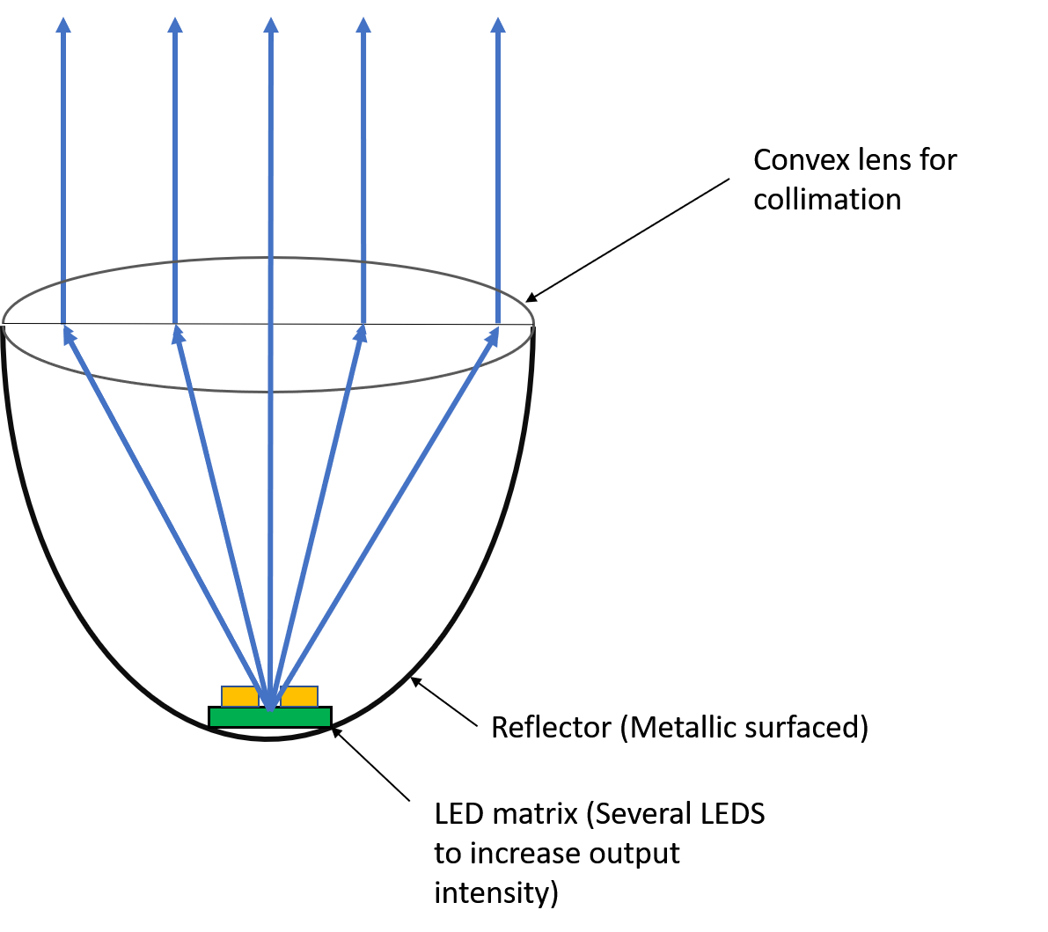
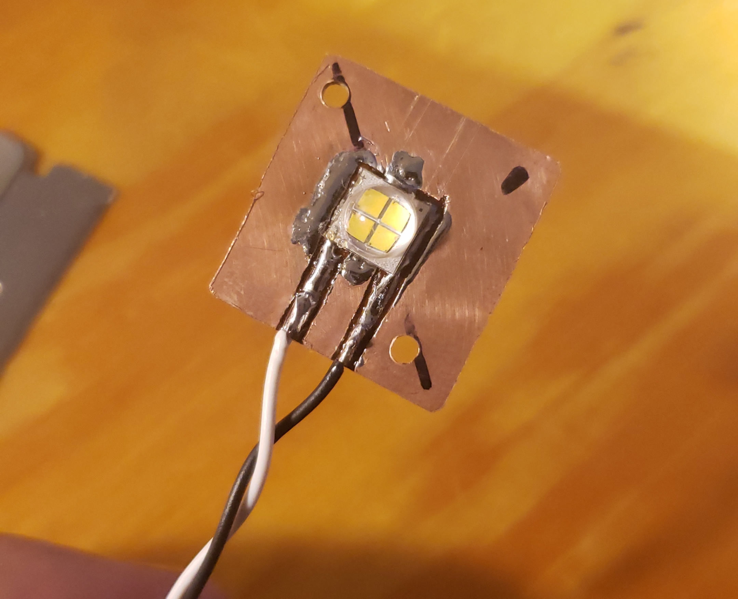
Low Beam design
Projector style assembly
Used to magnify the LED array and easily control the beam divergence.
LED color selection
A white source similar in color to halogen bulbs provides the best balance of comfort and visibility characteristics.
Part Number​ | Vendor​ | Lumens​ | Viewing Angle | Size (mm)​ | Price​ | Color Temp.
MKRAWT-00-0000-0B0HG440F | Mouser | 840 | 120 | 7 x 7 | $ 5.90 | 4000 K
XHP50A-00-0000-0D0HH250G | Mouser | 900 | 120 | 5 x 5 | $ 4.60 | 5000 K

Slide 9
Lenses
We are testing two lens diameters
Diameter | 10 mm | 20 mm
Focal Length | 7 mm (Seller reference only) | 16.5 mm
Cost | $0.85 | $1.00

Slide 10
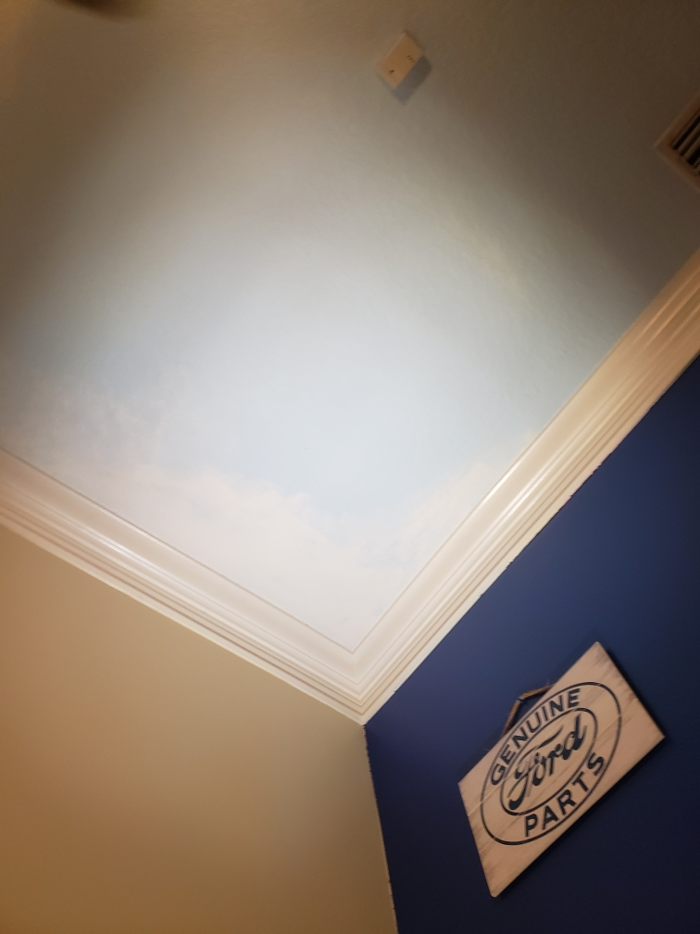
Projected Beam Shape
In focus | Slightly out of focus | Slightly out of focus
*Different LED (same physical dimensions) using 20 mm lens

Slide 11
High Beam
Reflector Bucket assembly
We decided upon an elliptical reflector based high beam to allow for control of large area illumination and present other forms of lighting design.
LED color selection
Broad band source of high intensity to aid in clarity of reflections.
Part Number​ | Vendor​ | Lumens​ | Viewing Angle | Size (mm)​ | Price​ | Color Temp.
MKRAWT-00-0000-0B00H40E2 | Mouser | 970 | 120 | 7 x 7 | $ 5.90 | 5700 K
MKRAWT-00-0000-0B00H440F | Mouser | 970 | 120 | 7 x7 | $5.80 | 6200 K

Slide 12
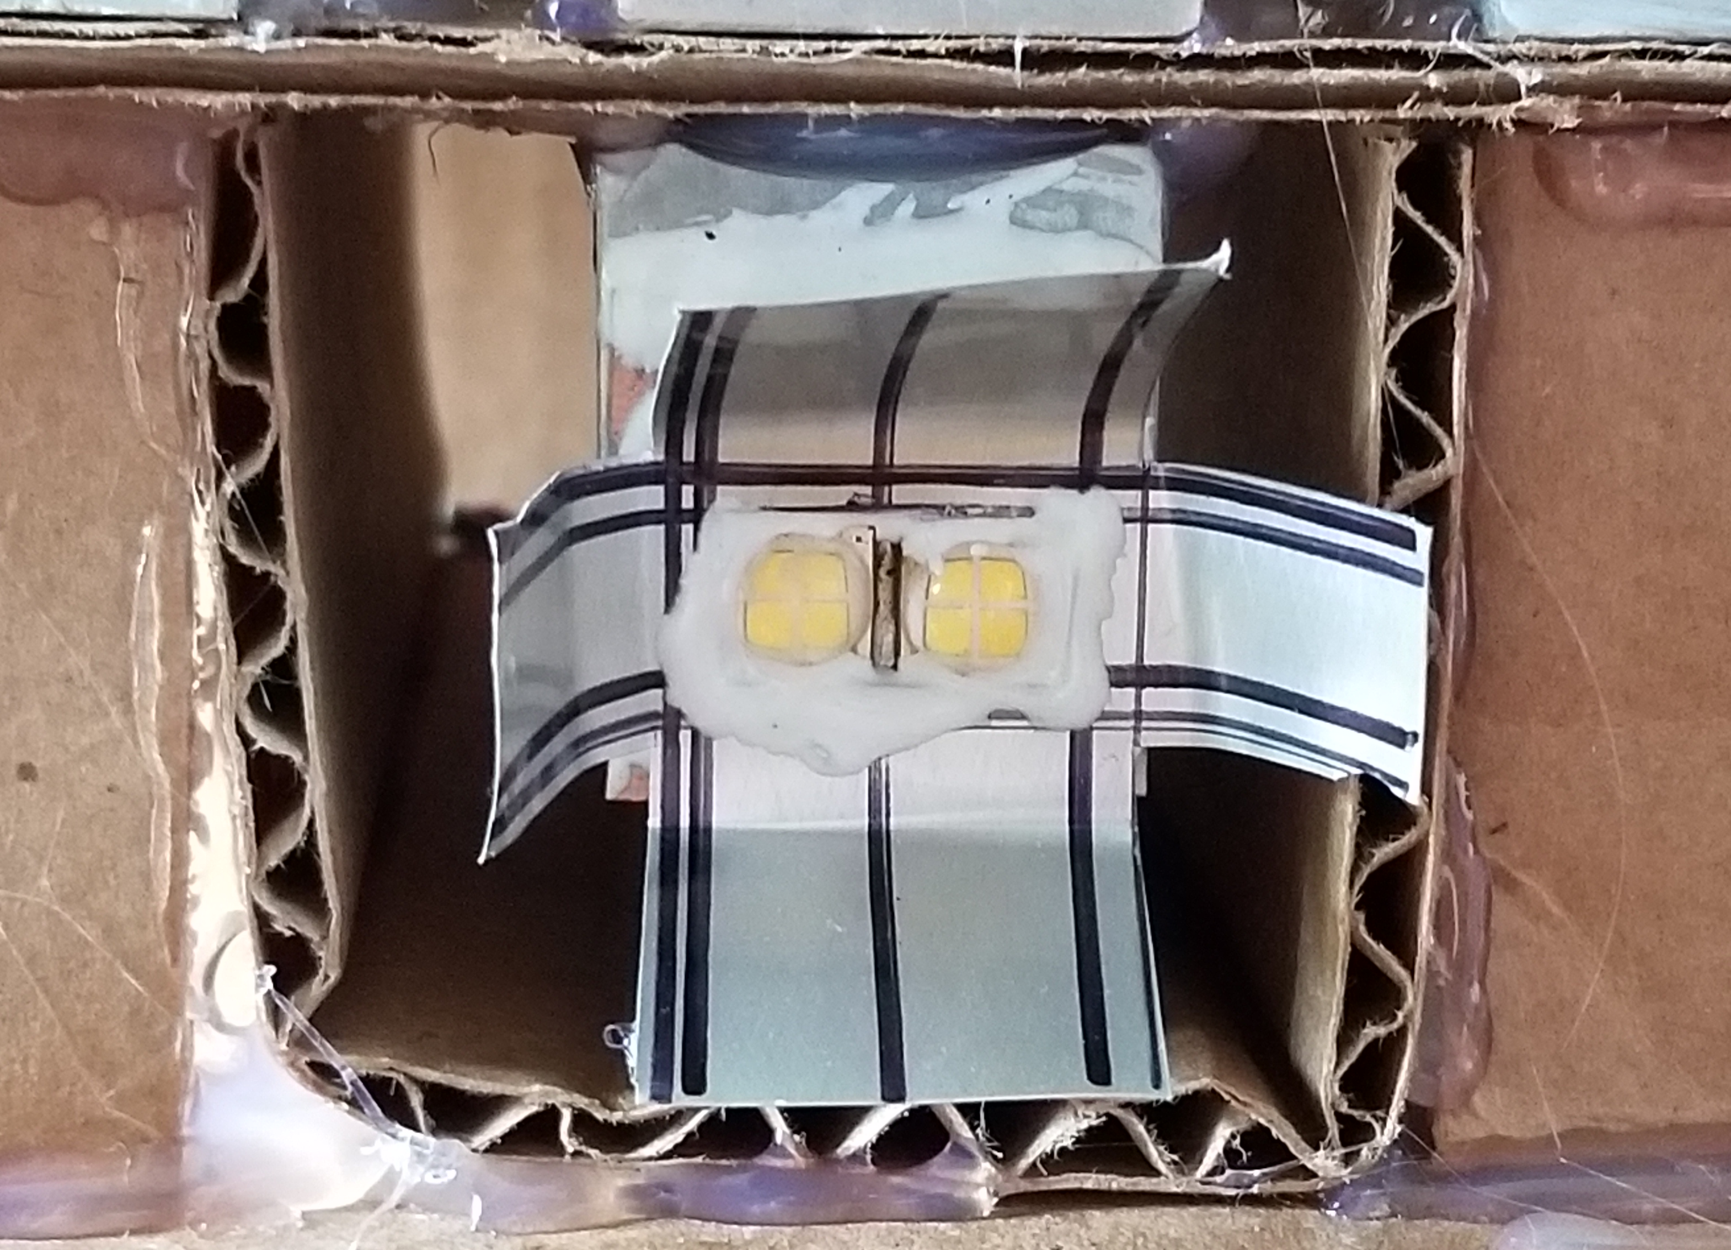
Fog Light
The beam shape is to be rectangular in which the light expands rapidly to cover the width of the road but a small divergence in the y-axis such that the light stays low and path does not extend up into the fog impairing vision.
Part Number​ | Vendor​ | Lumens​ | Viewing Angle | Size (mm)​ | Price​ | Color Temp.
MKRAWT-00-0000-0B0HG440F | Mouser | 840 | 120 | 7 x 7 | $ 5.90 | 4000 K
XHP50A-00-0000-0D0HH250G | Mouser | 900 | 120 | 5 x 5 | $ 4.60 | 5000 K

Slide 13
Rain Sensor
$$φ_{c}$$
Index of Refraction | Critical Angle = $φ_{c}$ | Angle from interface = $θ_{c}$ | Angle of incidence = $θ_{i}$
$n_{1}=1.492$ ${ n}_{2}=1.000$ | 42.086º | 47.914º | >90º
Solution: Cut the acrylic face to position normal along desired beam path θ = 137.914º/42.086º

Slide 14
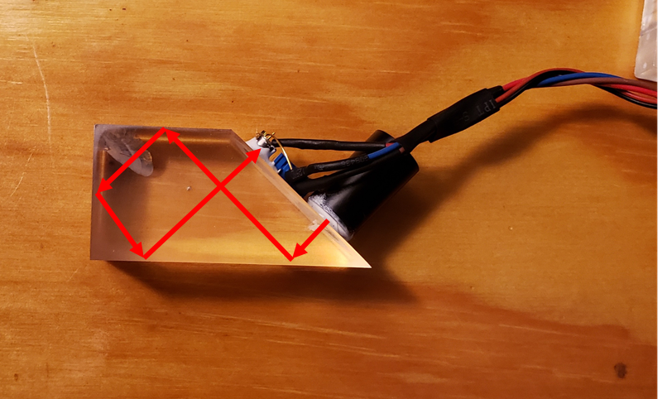
Rain Sensor
Phototransistor
$$φ_{c}$$
Laser Diode
Index of Refraction | Critical Angle = $φ_{c}$ | Angle from interface = $θ_{c}$ | Angle of incidence = $θ_{i}$
$n_{1}=1.492$ ${ n}_{2}=1.000$ | 42.086º | 47.914º | >90º
Solution: Cut the acrylic face to position normal along desired beam path θ = 137.914º/42.086º

Slide 15
Light Sensor
Determines if the headlight should be on (reads ambient light)
Program output states
Daylight (LOW)
Dusk to Dawn (HIGH)
Proposed program two output bits
Day/Night
If Night and if signal level was extremely low there was to be a bit raised to command the high beam
This function was nulled in the program due to PCB input issues the pins wired for input were not capable of receiving an analog input

Slide 16
Rain and Light Sensor Paired

Slide 17
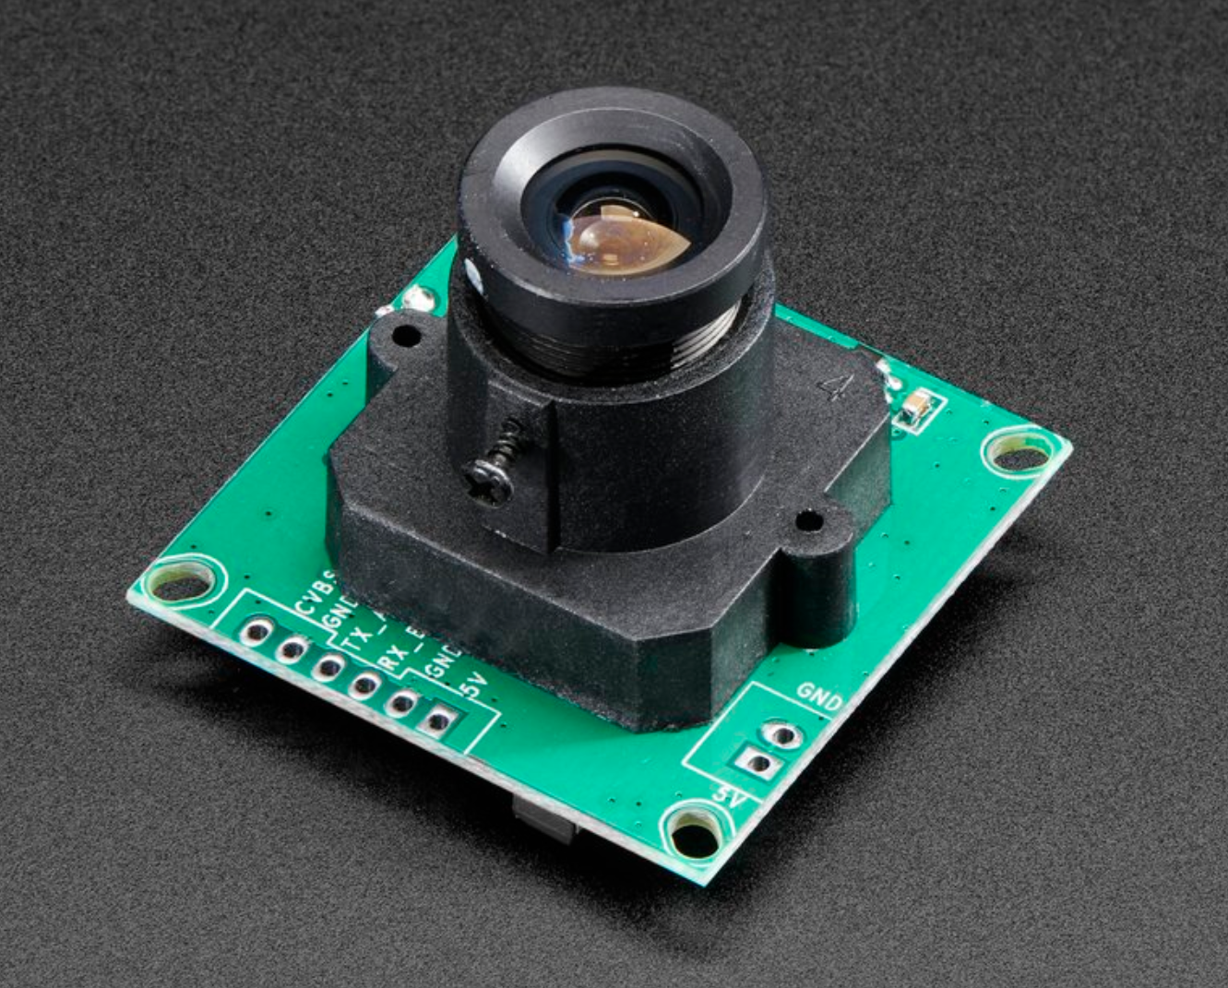
Camera system
Picture is needed to determine which LEDs will be on
The microprocessor will analyze the picture taken
Set the LEDs to their states
Camera | Part Number | Price | Vendor | Resolution
TTL Serial JPEG Camera with NTSC Video | 397 | $39.95 | Adafruit | 160X120
CCD Black & White Camera | X | $4.99 | Skycraft | 752X582

Slide 18
What the unit sees

Slide 20
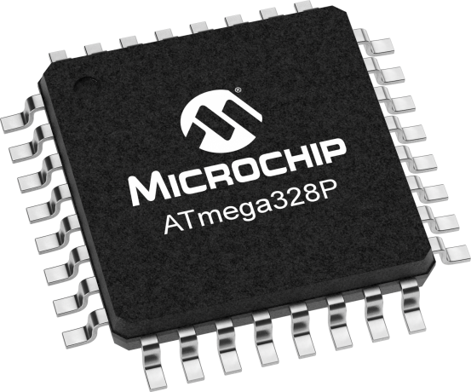
Microcontroller
We have been using an Arduino for testing
Chip used on the board is an ATmega328P
Part Number | Price | Pins | Processing Speed
ATMEGA328P-AU | $2.01 | 32 | 8-bit
SAM3X8E ARM | $18.99 | 116 | 32-bit

Slide 21
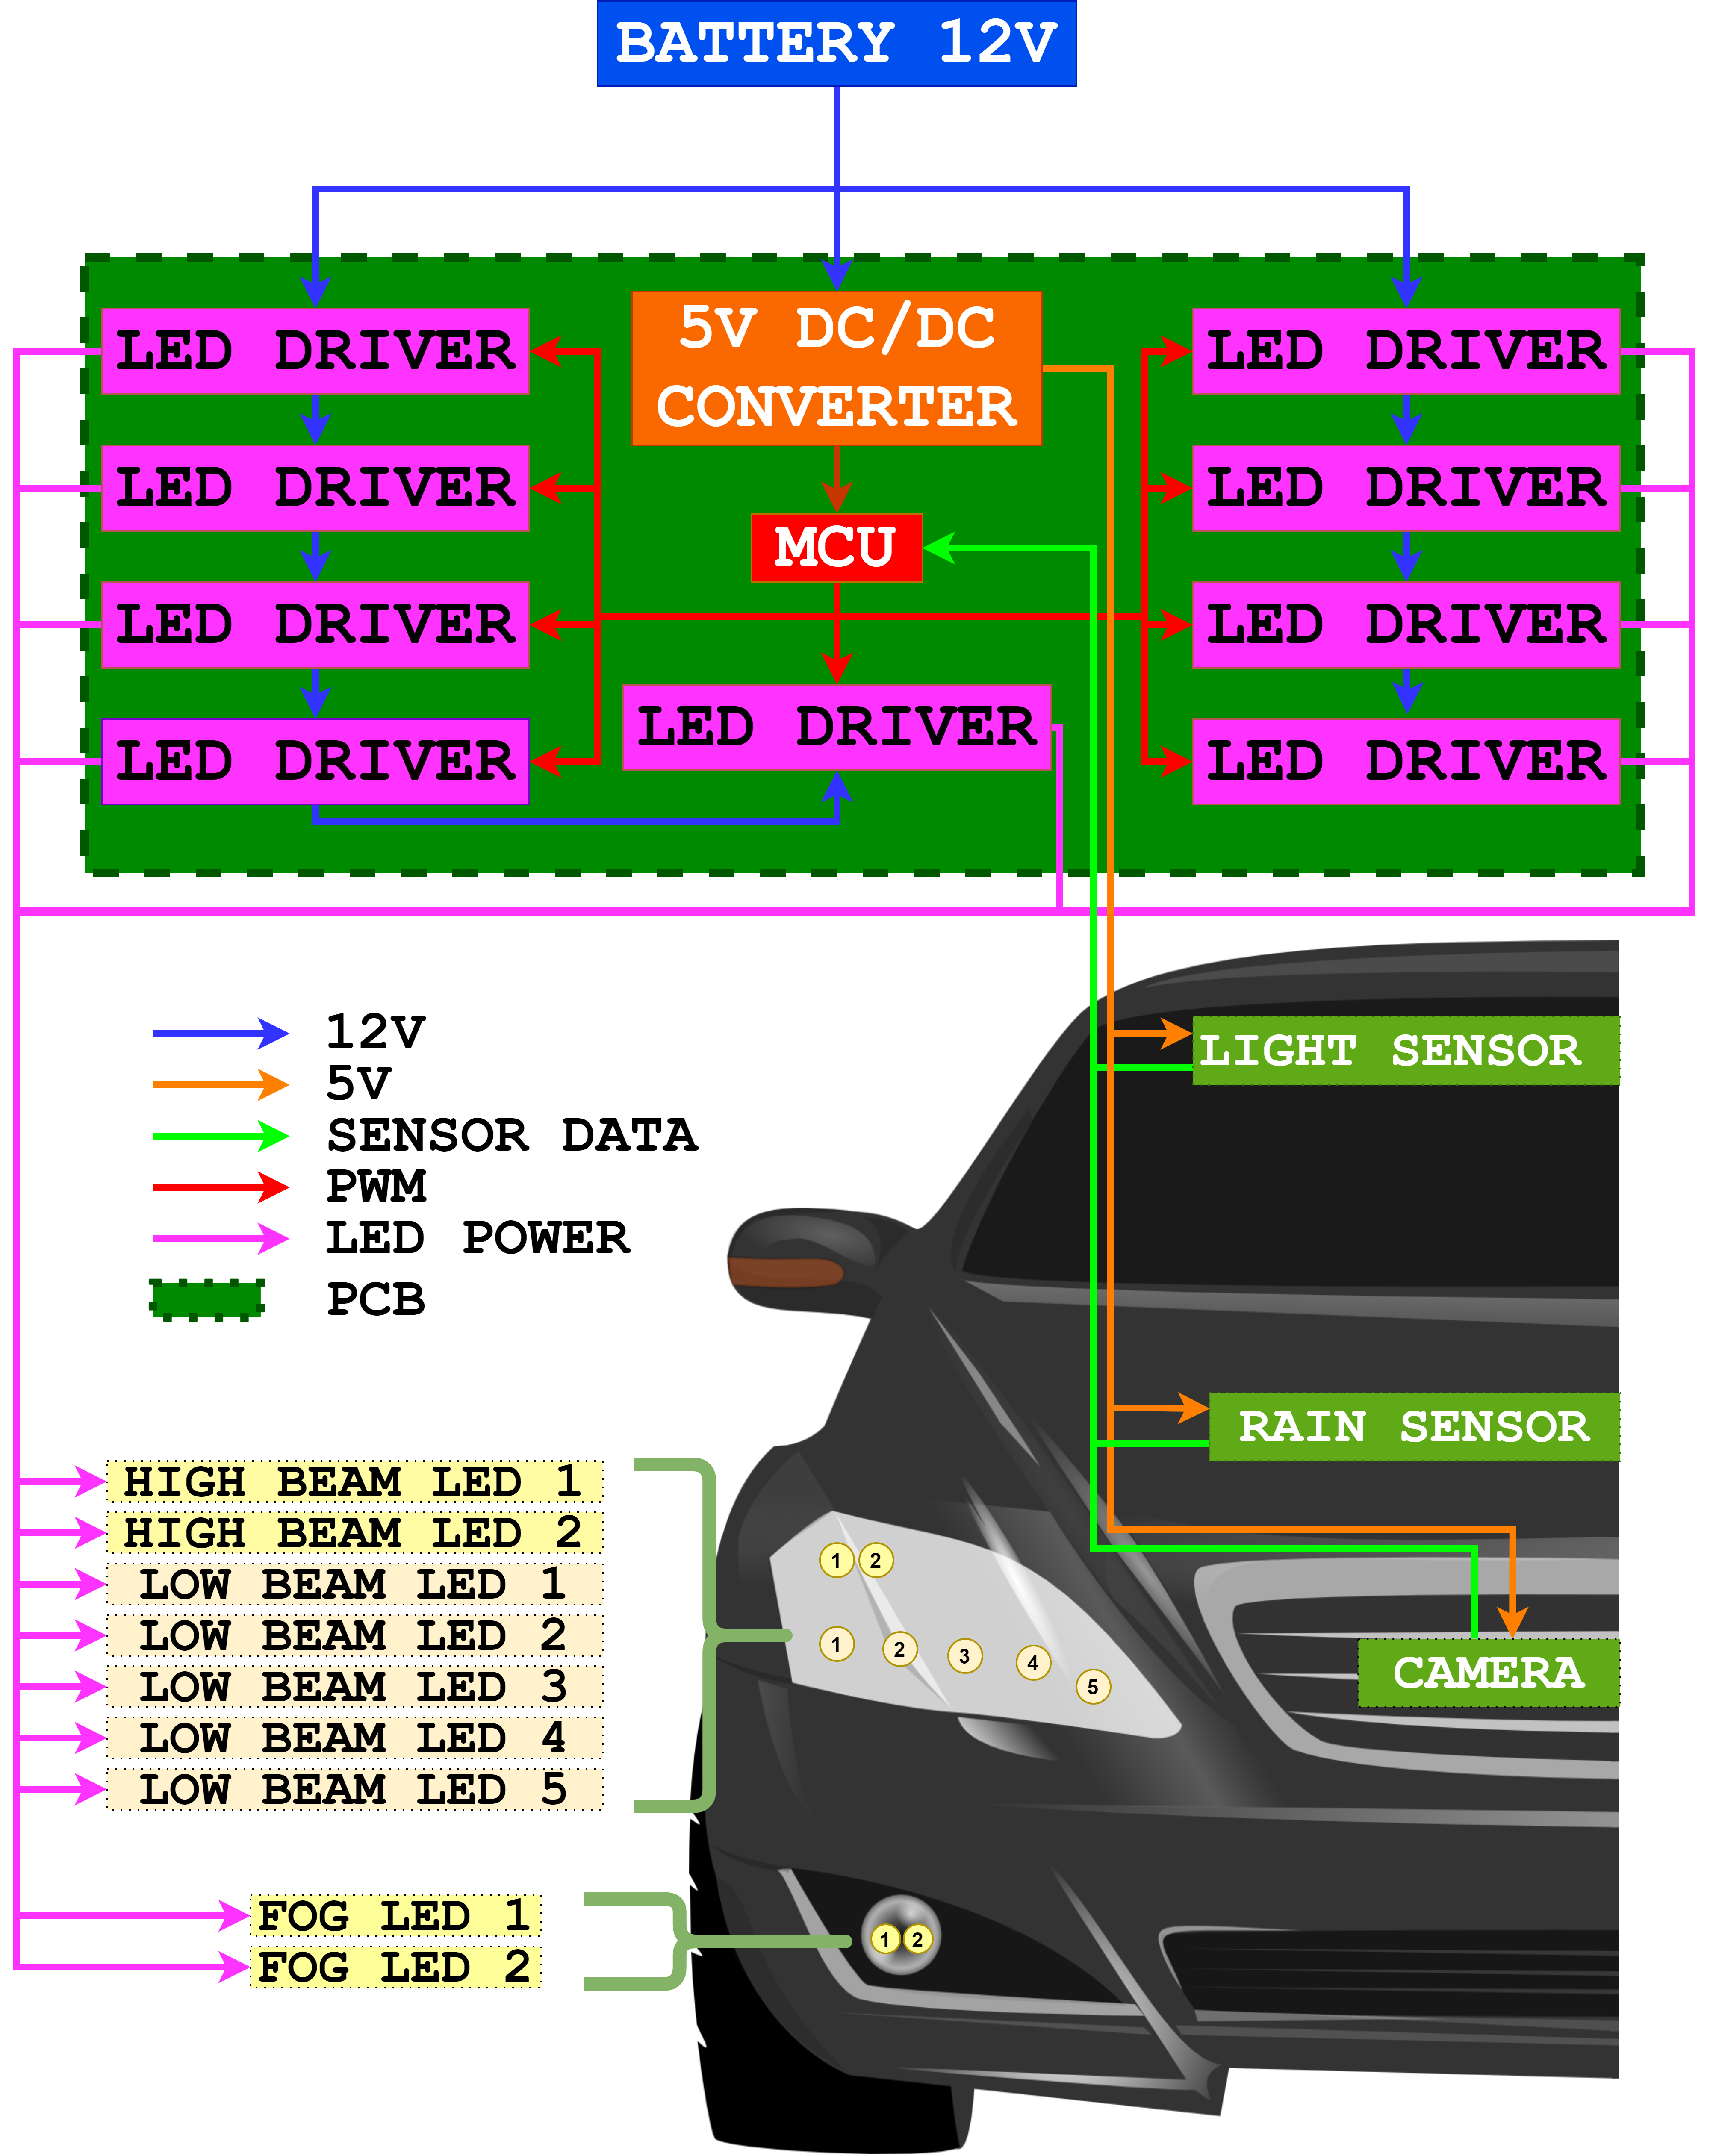
Electrical Systems Overview
Notes:
Now onto the electrical system
Ideally the car battery will act as a steady 12 volt source
These 12 volts supply power to the nine LED drivers that then power the 9 LEDS in the highlight
Lastly we need 5 V dc regulator to step down the voltage to our MICROCONTRLLER
LASER DIODE, CAMERA and LIGHT SENSOR

Slide 22
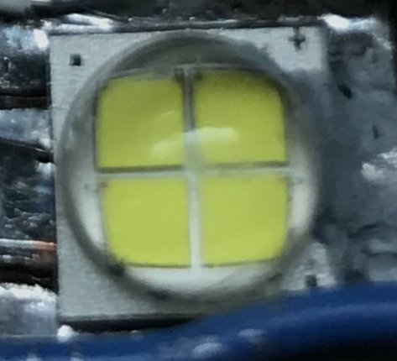
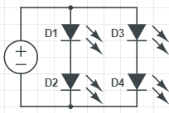
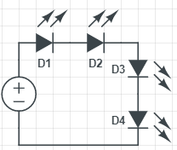
LED Power Requirements
Two configurations (6 Volts or 12 Volts)
Aiming for 1.4 amps
Constant Voltage(CV) vs. Constant Current(CC)
Notes:
The LEDS we are using have 2 voltage options
We went with the 6 volt option since it was easier to design LED driver that stepped down the voltage and stepped up the current to around 1.4 amps

Slide 23
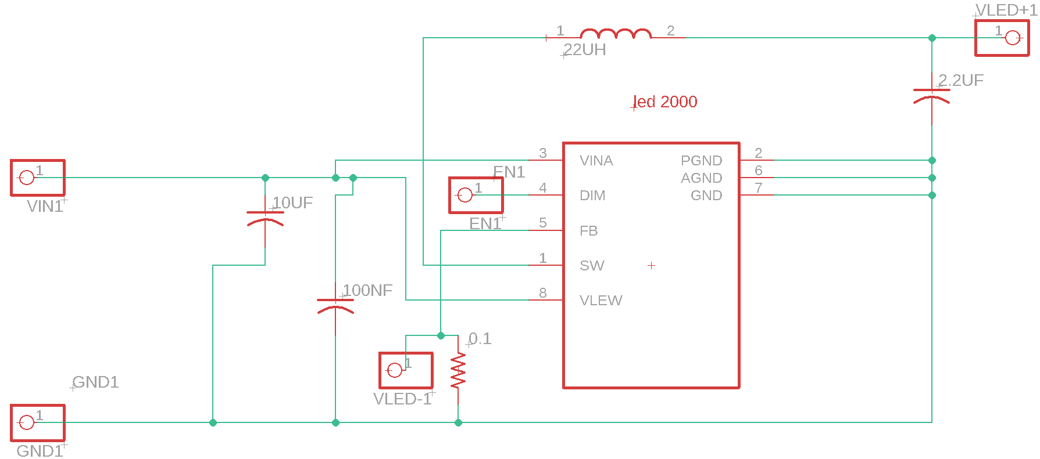
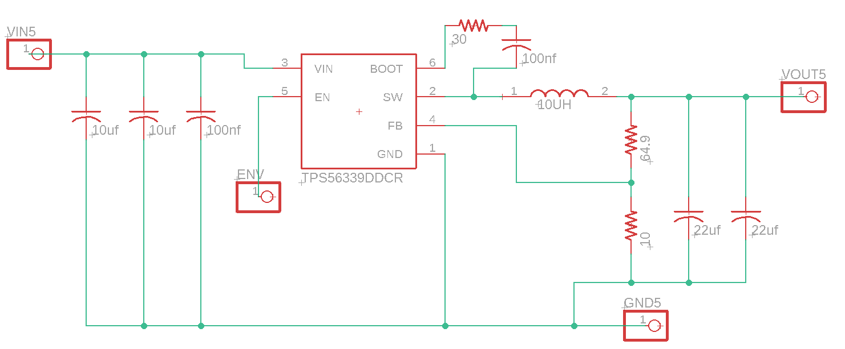
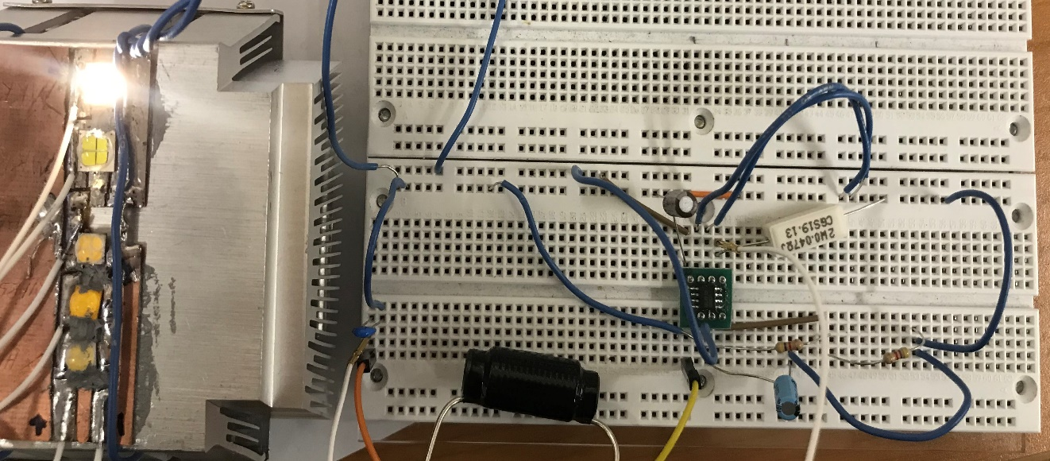
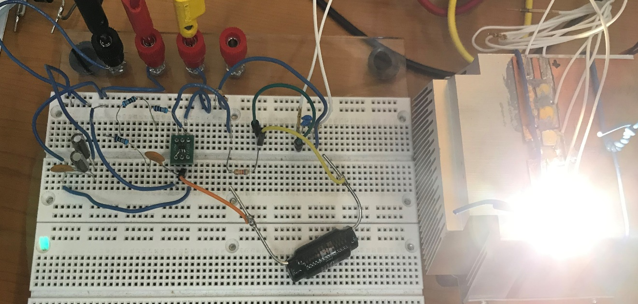
LED Drivers Rev. 1
LED driver IC on a Breakout Board
Through hole components
Issues
LED2000 CC
TPS56339 6 V CV
Notes:
For my first attempt at making LED drivers I bought these two ICs and soldered them onto the breakout board
And none of them work properly

Slide 24
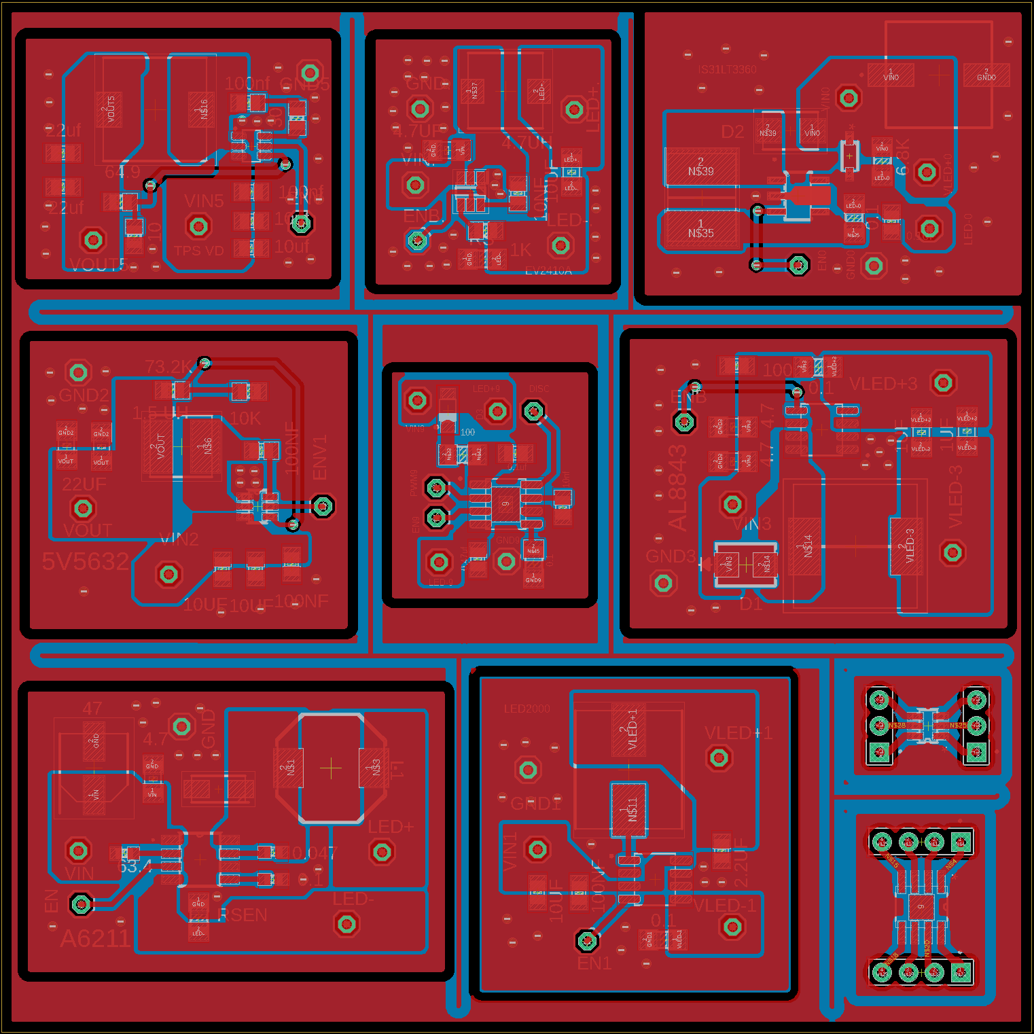
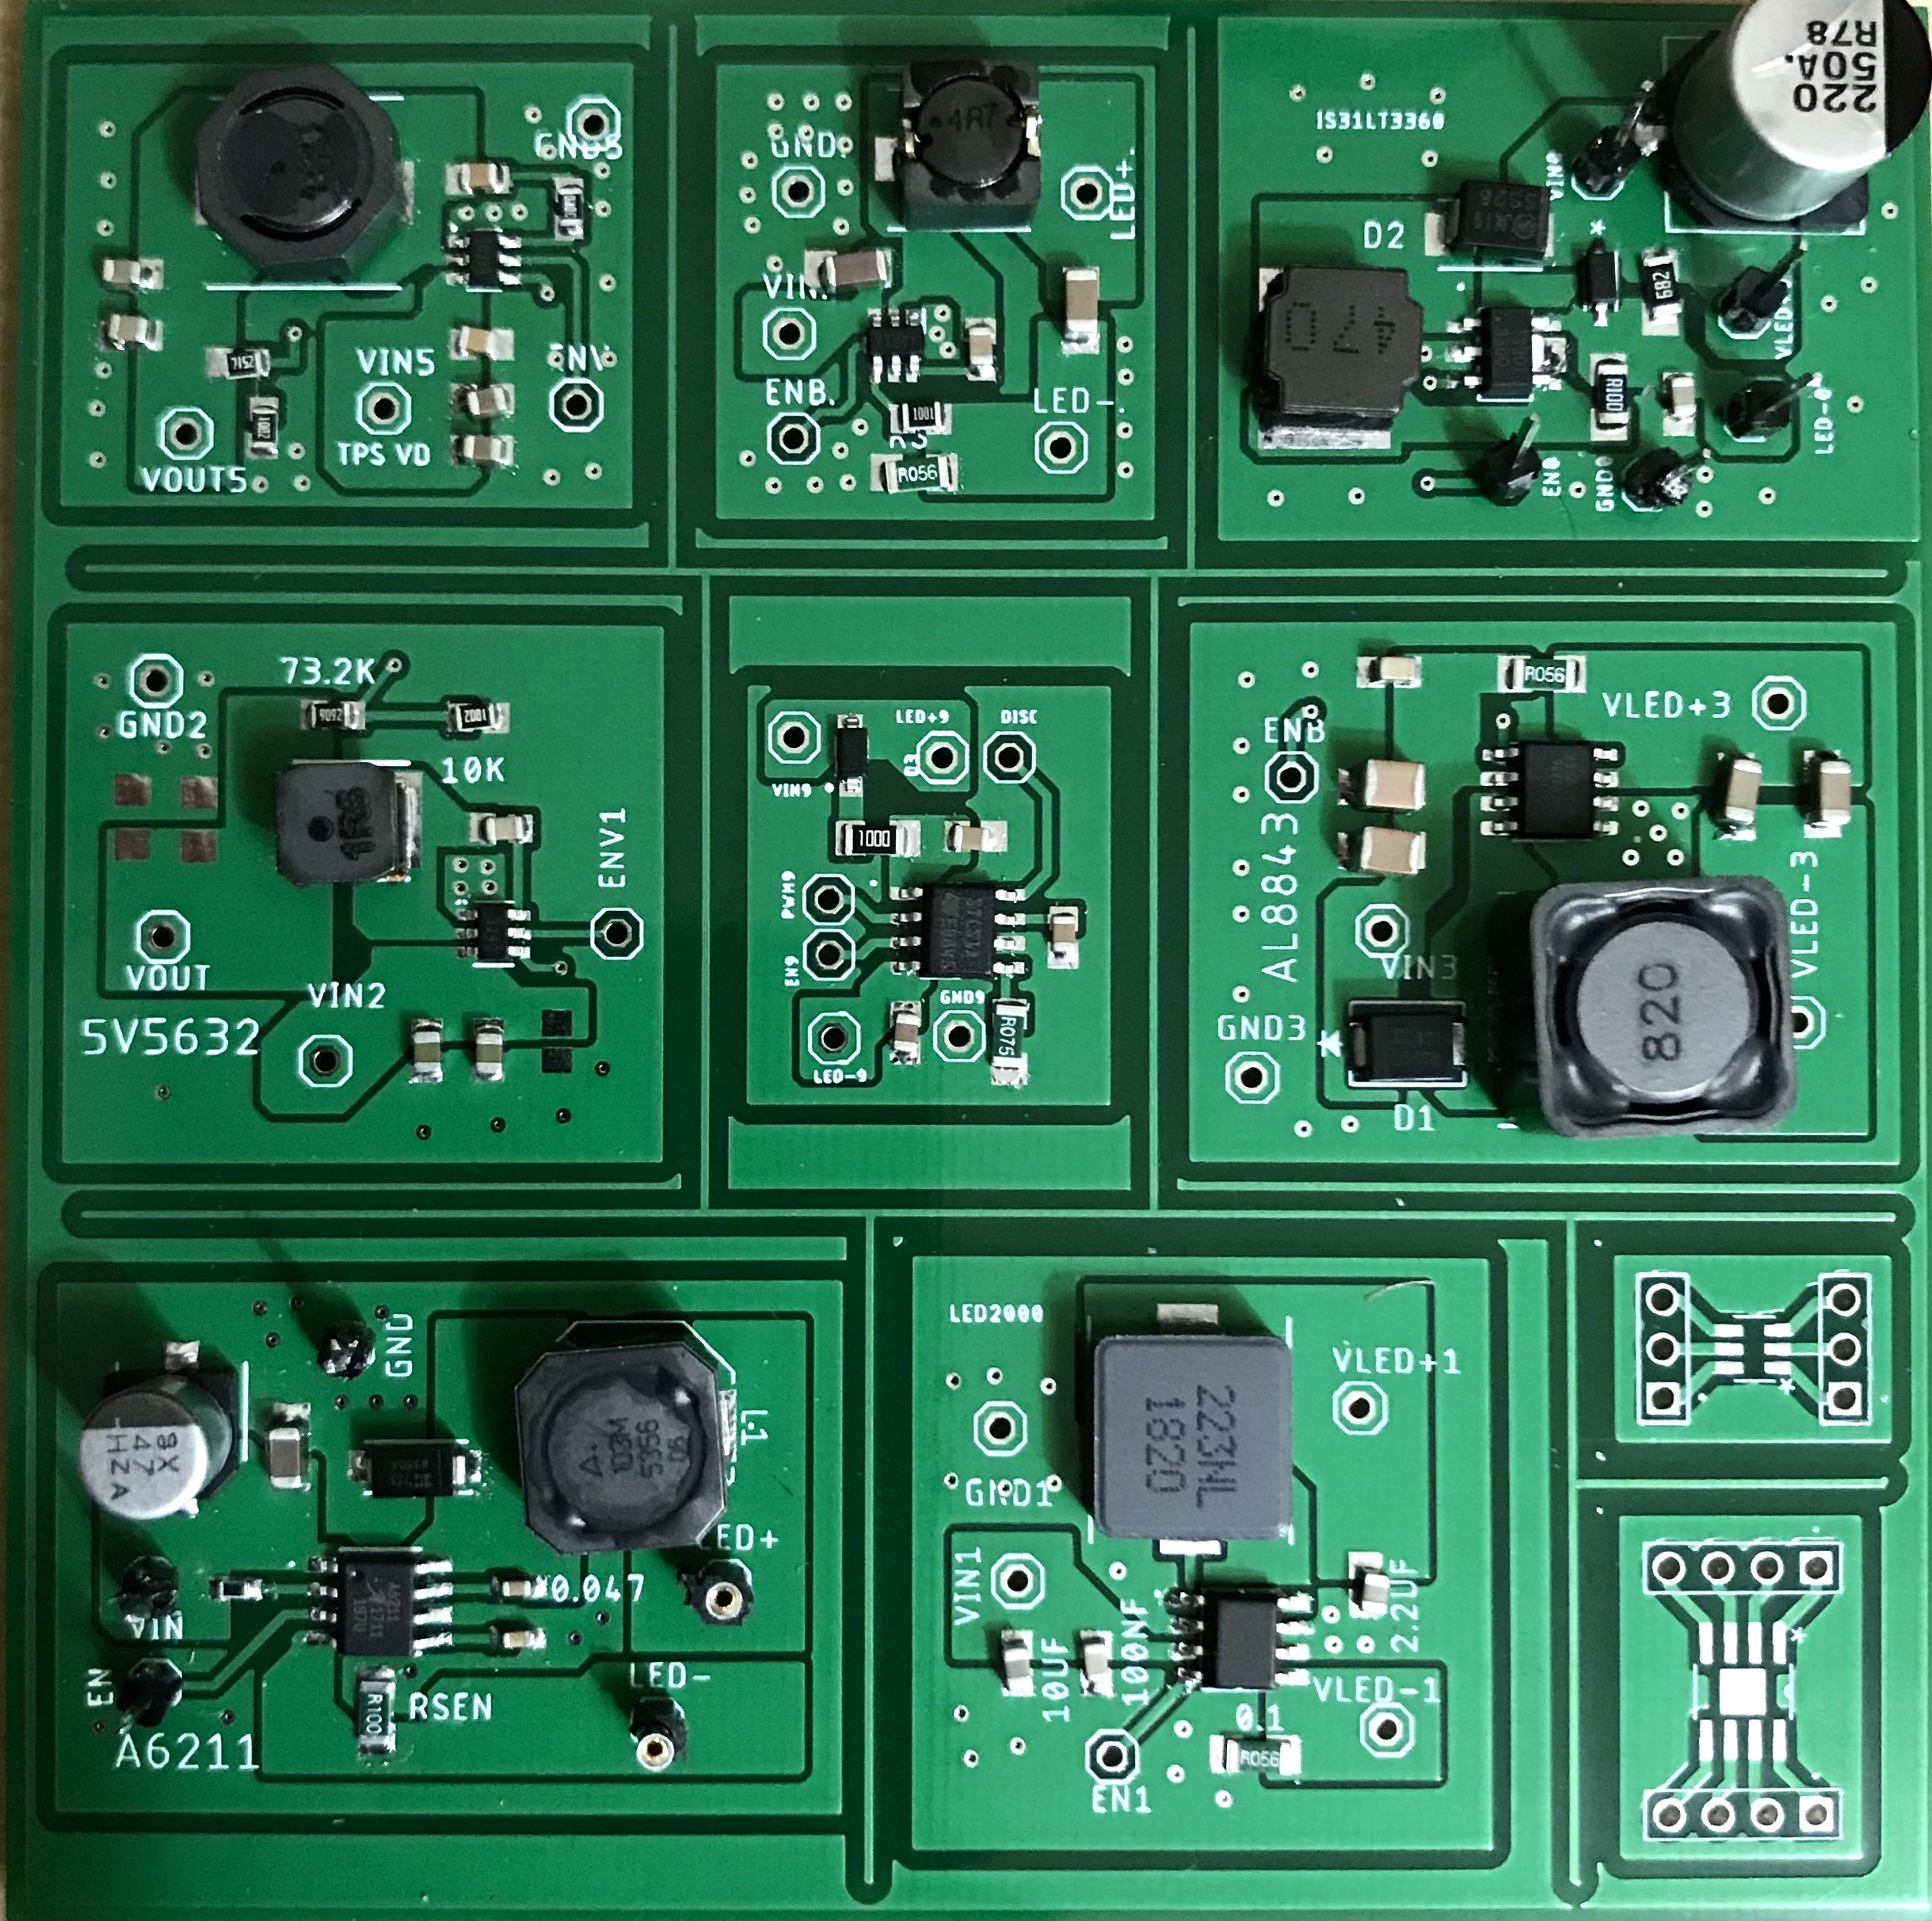
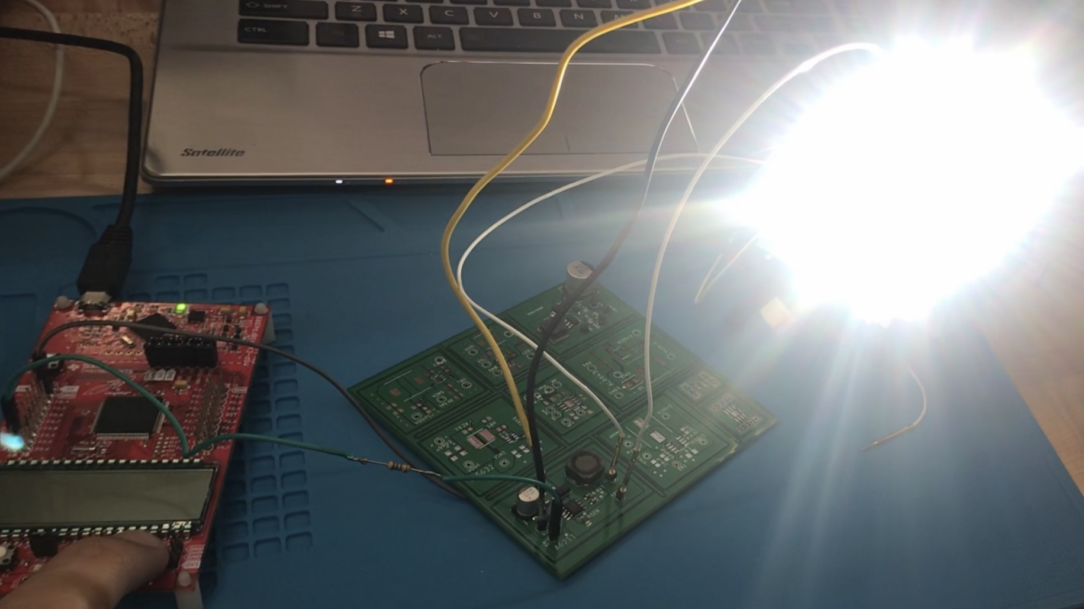
LED Drivers Rev. 2
LED driver design revisions
Added more drivers
All SMD components
6 VOLT CV
MP2410AG CC
IS31LT3360 CC
5 V DC-DC
STCS1A CC
AL8843 CC
PCB Detail
Cost: 2$ + 12.70$ shipping
1 oz copper
2 layers
Dimensions: 100mm*100mm
Manufacturer: JLCPCB
A6211 CC
LED2000 CC
Notes:
So I tried again this time I researched more LED driver
And design a PCB for them to test individually

Slide 25
LED Driver Comparison
 | A6211 CC | LED2000 CC | AL8843 CC | STCS1A CC | TPS56339 CV | MP2410AG CC | IS31LT3360 CC
MANUFATURE | Allegro MicroSystems | STMicroelectronics | Diodes Incorporated | STMicroelectronics | Texas Instruments | Monolithic Power Systems Inc | Issi
COST OF ONE DRIVER | $3.84 | $4.82 | $5.53 | $5.37 | $4.15 | $4.38 | $3.70
Vin (V) | 6 - 48 | 3-18 | 4.5 – 40 | 4.5 – 40 | 4.5 - 24 | 4.2 - 24 | 6 - 40
MAX IOUT (A) | 3 | 3 | 3 | 1.5 | 3 | 2 | 1.2
Efficiency (%) | 87 | 92.5 | 91.2 | 90 | 93 | 94.2 | 85
Notes:
After testing all 7 LED drivcers
I sellty on the A6211

Slide 26
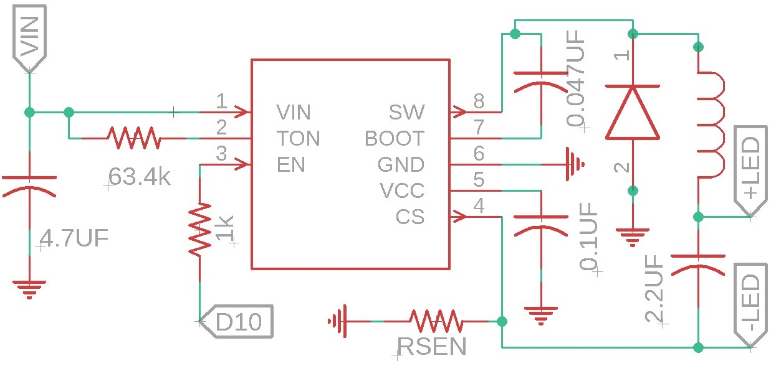
Final LED Driver Design
A6211 CC
MANUFATURE | Allegro MicroSystems
COST OF ONE DRIVER | $3.84
Vin (V) | 6 - 48
MAX IOUT (A) | 3
Efficiency (%) | 87
Notes:
Its essentially a constnat current buck converter
It was among the cheapsest and reailble
And offered my featureas and it was easily controllerable through PWM

Slide 27
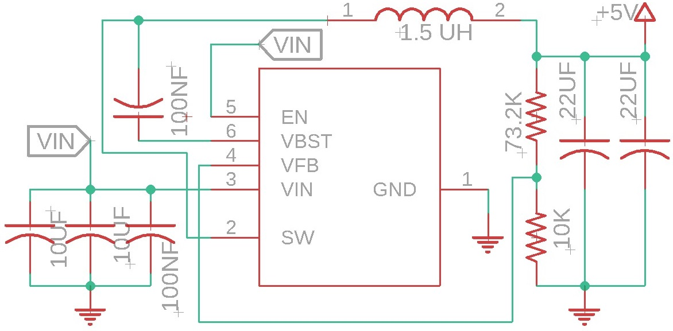
5 Volt Sensor and MCU Power Supply
TPS563240
MANUFATURE | Texas Instruments
COST OF ONE DRIVER | 3.55
MAX IOUT (A) | 3.5
Efficiency | 91.3
Vout(V) | 0.6 - 7 (Adjustable)
DC to DC Buck converter
Notes:
To power our
LASER, LIGHt Sensors and microncontrollers
I designed this 5 Volt DC-DC regulator

Slide 28
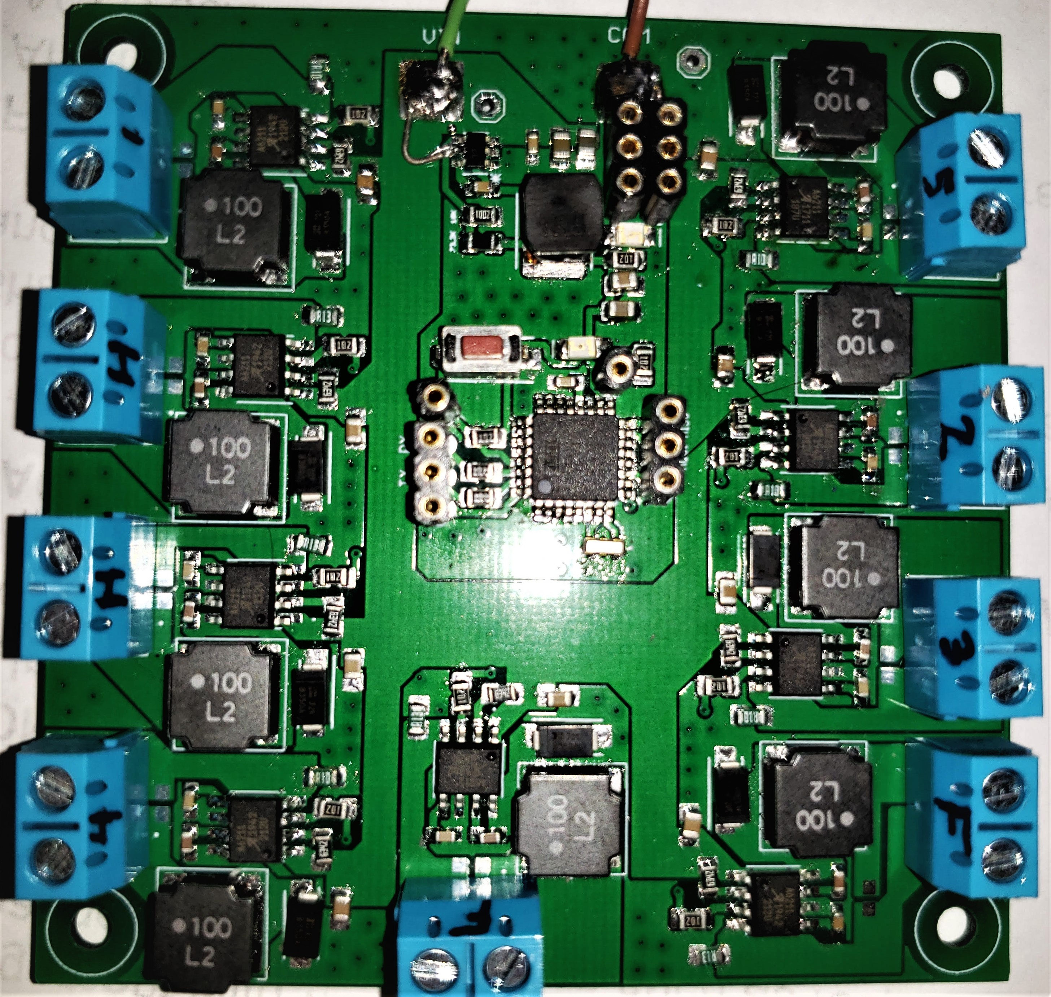
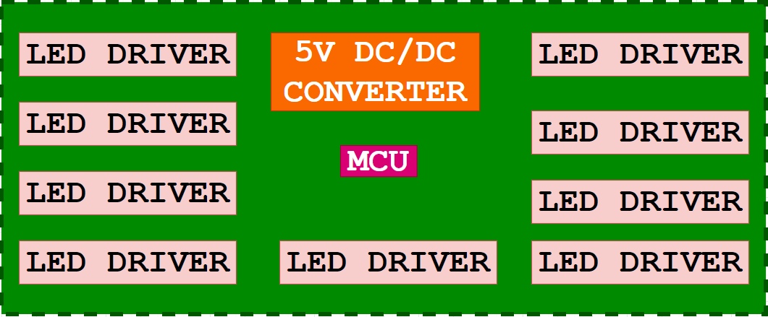
Final PCB Design
PCB Details
1oz copper
2 layer
66x67 mm
Manufacturer by JLCPCB
Notes:
Lastly I put everything together onto my FINAL PCB BOARD
It’s a strighfoawdr 1 oz copper 2 layer board
I tryied to minimizes the boardsizes as much as possible to 66x67 mm
It features
Terminal block for easier connectivey to the LED
Pins for programing for Microcontller
Power for the sensors and
Reading sensor data
And a couple LED indicators

Slide 29
Administrative Content

Slide 30
Work Distribution
 | Justin Kleier | Michael Zeiher | Justin Owle | Ivan Bernal Garcia
LEDs | PRIMARY | SECONDARY
Low Beams | PRIMARY | PRIMARY
High beams | SECONDARY | PRIMARY
Rain Sensor | PRIMARY | SECONDARY
Fog lights | SECONDARY | PRIMARY
Ambient Light | PRIMARY
LED Drivers |  |  |  | PRIMARY
PCB |  |  | SECONDARY | PRIMARY
MCU |  |  | PRIMARY | SECONDARY
Camera |  |  | PRIMARY
Image Processing |  |  | PRIMARY

Slide 31
Financing
This project is funded entirely by the group. Our goal was to keep the cost of the project below $500.
We are over budget at $623.21
We went over budget due to thorough prototyping and having to purchase excess materials and equipment needed that were not accessible with current events. (Scrap aluminum, acrylic, passive electrical components and shipping)
Overall cost is over budget but as some components were personally loaned to the project from members, the amount truly spent is currently $534.41.

Slide 32
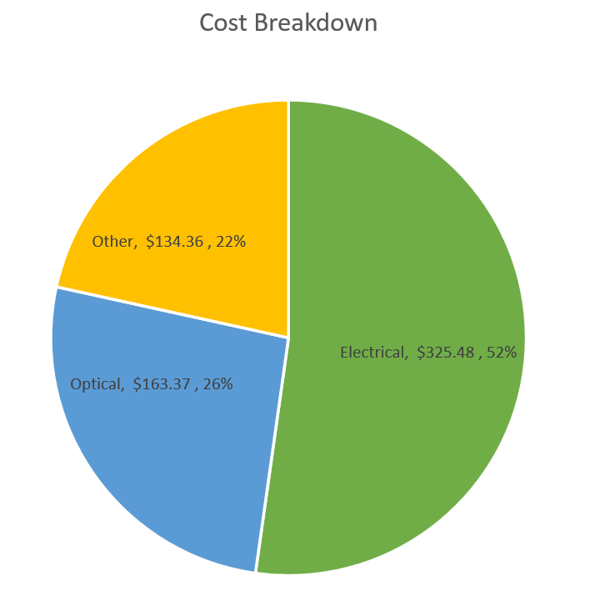
Budget

Slide 33
Issues With Final Product

Slide 34
Questions

